Slide 1
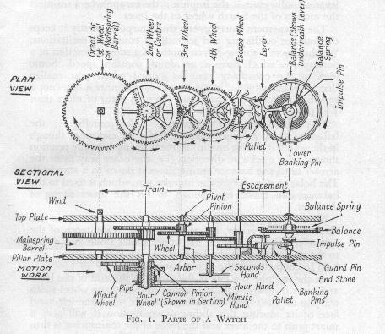
Year one watchmaking course

Slide 2
About the course – Year One
Entry Level - assuming no prior knowledge of watch mechanics.
The course is held over 40 weeks (120 hours).
Three hour lessons. Each week 30 – 45 minutes of theory followed by a practical session.
Lessons in Power-point format will be ‘Drop-boxed’ (cloud based storage) weekly prior to the lesson.
Gain skills in servicing hand-wound mechanical movements.
History and development of watchmaking.
Tools, techniques and workshop practices.
2

Slide 3
Topics covered
Opening watch cases.
Tools: selection, uses & maintenance.
Uncasing movements: safe removal & replacement of stem, hands, dial & movement.
Disassembly, reassembly and checking of movement for faults.
Lever escapements: action of all parts – checking, adjusting & regulation.
Removing, fitting & replacing mainsprings.
Keyless-work variations and understanding functions of parts.

Slide 4
Topics covered
Gain skills in fault finding .
(Understanding how a watch works and why it doesn’t).
Using a watchmaker’s staking tool.
Bench metalwork skills - cut, file, shape & polish.
Acrylic, mineral & sapphire crystal removal and replacement.
Theoretical and practical aspects of watchmaking.
Using a watch cleaning machine.
Oiling of jewels.
Polishing pivots & pinions. Using a jacot tool

Slide 5
Topics covered
Adjusting balance springs.
Watch jewels – Replacement and adjustment
Making hand levers – Annealing, hardening & tempering skills.
Adjusting and regulating working serviced movements.
Using a timegrapher – fault finding & timing.
Detailed understanding of how the Swiss lever escapement works.
Full strip down, fault finding, cleaning, assembly, and lubrication of every movement in each module.

Slide 6
Topics covered
Ability to oil both shockproof and non shock-proofed cap jewels in vintage and modern watches.
Ultimately, gain an intimate understanding how a watch works, why it works in that particular way and what to do to correct most faults.

Slide 7
Qualifications
The course does not provide a qualification of its own, but the structured beginner’s watchmaking lessons aim to provide a practical and theoretical understanding in watch servicing and repair, as well as some handy techniques and tips.
If you are thinking of gaining a professional qualification in the future, we recommend you bring a camera to document your progress, and also make your own notes, which you may add to a portfolio in the future.
We can advise you of course options, if you want to take watchmaking up professionally.
Three previous students who completed the first and a second year courses are now employed as watchmakers and technicians as a full time career.
7

Slide 8
What you can achieve
If modules of the course are followed and more ‘bench-time’ is completed at home, then there is no reason why you won’t have the confidence and ability to service most hand wound mechanical wristwatches by the completion of this 120 hours course.
If you set up your own work area at home and work on more watches in your own time, then you will better understand both the theoretical and practical aspects of the course.

Slide 9
What you need
All tools needed for the course are available in our ‘starter’ tool boxes, which you can use for the first six weeks.
After several weeks, we expect you to start building up your own collection of tools to use. By week 5 or 6, we expect you to have your own toolkit and toolbox.
It will cost approximately £150 for a basic tool kit, not including the price of a tool box. (You will appreciate your own tools, rather than having to sharpen student borrowed tweezers and screwdrivers!)
More tools will be needed through the course, other than the ‘starter’ toolbox, if you want to do more and achieve more at home.

Slide 10
What you need
Depending on the quality of the tools you buy, you can easily double that amount, especially when buying ‘Bergeon’ screwdrivers and ‘Dumont’ tweezers. You will be adding tools to this basic kit as you progress .
I always say, “Buy what you can afford”.
Don’t buy really cheap, as you end up buying twice. I will provide links and guidance as to what tools, prices and where to get them, but you don’t need to worry about tools for now.

Slide 11
What you need
I always advise students to start by buying these seven particular books.
‘Practical Watch Repairing’ – by Donald De Carle.
‘The Watch Repairer’s Manual’ – by Henry B Fried.
‘The Watch Repairer’s Manual’ – by H. Jendritzki
‘Bench Practices for Watch Repairers’ – by Henry B Fried.
‘Watch & Clock Making & Repairing’ – by W J Gazeley.
‘The Watch Escapement’ – by Henry Fried
‘The Theory of Horology’ – by Charles Andre Reymondin
This last book is expensive, by worth it!

Slide 12
What you need
If you want to take this up as a hobby or profession, then you will want certain tools at home such as a staking set and a jewelling set, that we have to use in the classroom. These two tools cost between £250 to £500 each, sometimes more, depending on the brand and the quality of the tool.
Watchmaker’s lubricants are ridiculously expensive. A set of four or five oils/greases will cost over £100.
A decent ultrasonic or watch cleaning machine may cost between £100 to £500 and the ‘waterless’ professional watch cleaning fluids and rinse will be about £60 to £100, but these will clean over 150 watch movements.

Slide 13
What you need
A timegrapher, tests to see how accurate the watch is keeping time, as well as other readings. The Weishi 1900 model, which I advise students to buy, costs approximately £150 to £200.
We have all of these tools and equipment for students to use in the classroom and stress it is not necessary to buy these items, but you may want to invest in your own equipment so you can do certain tasks at home and not have to wait for the next lesson to use them.

Slide 14
You’ll need the following watches
The first complete watch you are going to learn with is a copy of the ETA 6497 which is used throughout the world in watch schools. We already have these watches for your first lesson, so don’t worry! £80 is added to the course fee to cover the cost of this watch, which is yours to keep and any spare parts needed along the way.
You will need to obtain the remaining watches on which to learn with and follow the lessons. I suggest you get an eBay account to acquire these watches. I will talk more about which watches you need, so don’t stress, there’s no rush.

Slide 15
Movements we will work on
ETA 6947; a pocket watch movement in modern wrist watch form. We’ll be working on a copy of this renowned watch, made by Sea-Gull. This is a very big watch movement to gain an understanding of the part names and how each of the five sections of the watch works, before taking that understanding onto the next watch…
BFG Baumgartner 866 ‘pin pallet’ movement wristwatch. On this movement you’ll learn how to use a staking set, as well as service this ‘Roskopf’ type movement, which most watchmakers turn their noses up at. Find out why…
15

Slide 16
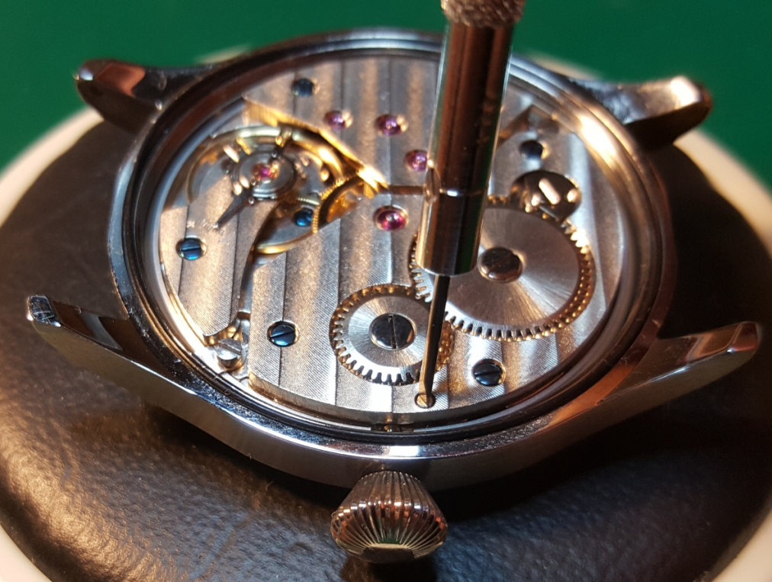
The first watch we’ll work on
The ST36 movement
This movement is a copy of the Unitas 6497 which was developed in 1949 as a modern and easily serviced pocket watch movement.
This is a big movement, which makes working on it easier!
This widely used teaching movement, available in a wide variety of case styles and at 36.6mm diameter is found in both pocket watches and modern oversize sports watches.
16

Slide 17
The 2nd watch we’ll work on
The Baumgartner BFG 866 is a ‘pin pallet’ watch with a centre-seconds hand, sold under various names.
This is worlds apart from the first watch in quality of parts.
These watches can come with a calendar, but only buy ones without this complication, as in the pictures. They don’t always come with a crown at the 4 o’clock position, but it is usual. A screw-back is favourable.
17

Slide 18
Movements we will work on
An Incabloc/shock protection calendar watch of your choice. Adding the extra ‘complication’ of a date wheel. This will give you an understanding of how the date wheel is driven and why it won’t, if there is a fault.
Luch 2209 movement. This is a remarkable 23 jewels Soviet watch, with an ultra thin and unusual layout. Also marketed as Sekonda de Luxe & Poljot, amongst other names. We’ll also really take a in depth look at the power transfer of the ‘gear train’ and fully understand how important that understanding is to diagnose some faults.
18

Slide 19
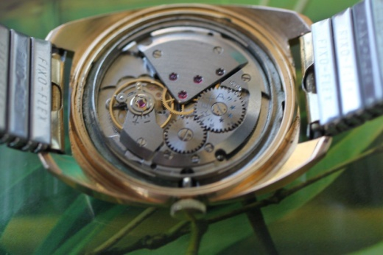
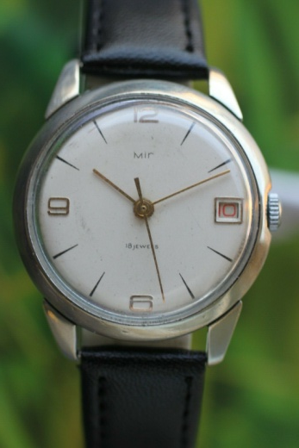
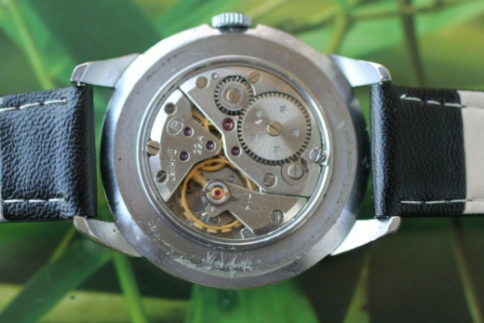
The 3rd watch we’ll work on
The next watch is a Swiss lever escapement, like the first watch, but with a date calendar. I have shown two very different layouts to the bridges, as well as different shock protections, so you can get an idea.
19

Slide 20
The 4th watch you need to obtain
The ‘ultra-thin’ 2209 movement, first introduced by Vympel and further branded by Poljot and Luch starting in 1961 through to the 70s. These 23 jewel movements are also sold as ‘Sekonda de Luxe’.

Slide 21
Movements we will work on
ETA 955.122 quartz watch. Showing this is a simple seven jewelled movement for a first time quartz watch servicing, although it has the added ‘complications’ of a day and date indicator as well as a ‘quickset’ function. We don’t electrical test this watch. That is covered in ‘Year two’.
A vintage 1930’s to 50’s ‘Indirect Drive’ centre seconds hand watch. This looks at a different way the centre second hand is powered, that is no longer usual in modern wristwatches. This will test your skills which you have gained in all the previous watches.
21

Slide 22
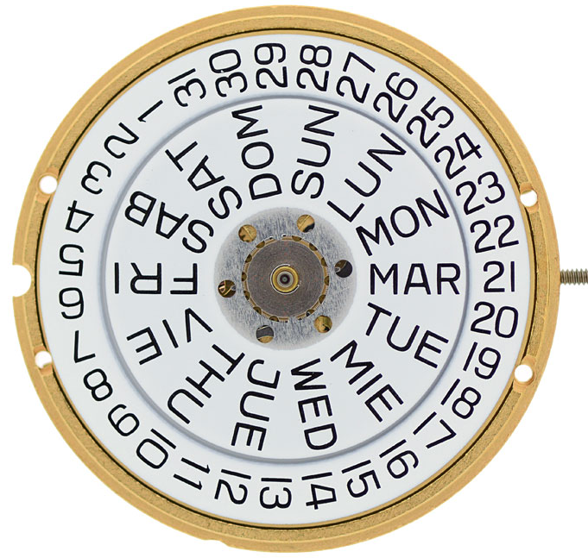
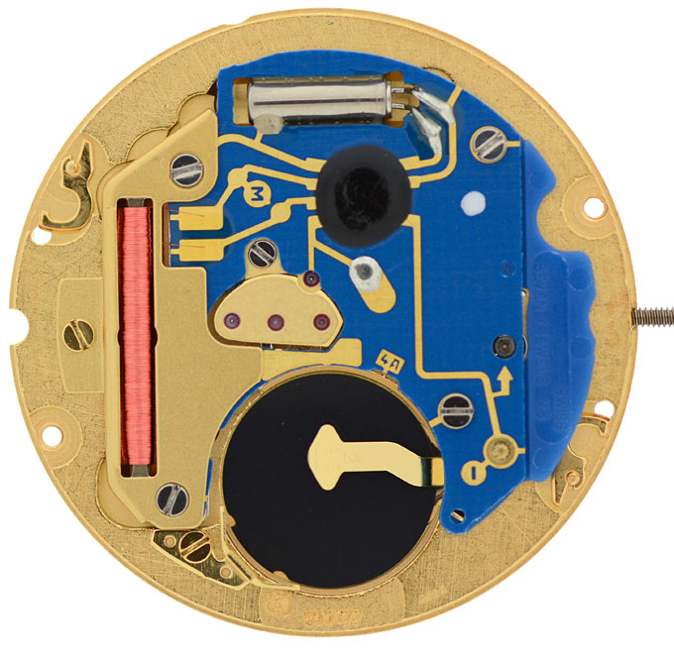
The 5th watch we’ll work on
The ETA 955.122 quartz movement.
This is a 7 jewel quartz movement, available for about £35.
I wanted to show how serviceable these relatively cheap quartz movements are, as you will find these in watches such as Tag Heuer costing several thousand pounds!
22

Slide 23
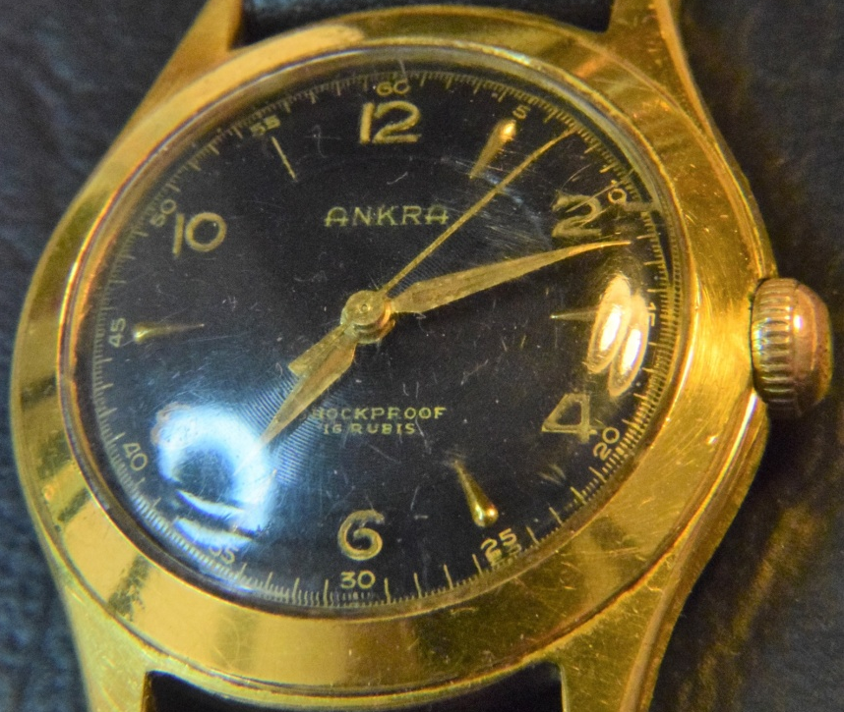
The 6th watch we’ll work on
An indirectly driven centre seconds hand watch popular up to the late 1950’s, exploring a design that doesn’t often get used in modern watches today.
23

Slide 24
Movements we will work on
I have included watches in this course that are affordable and available. Get an eBay account, if you haven’t already, as most of the watches you require are for sale there.
I also chose these particular movements because they will show you different aspects of how a watch is laid-out and different ways in which power is transferred through the wheels and pinions (wheel train).
The first watch is big and simple. You will spend the first few months familiarising & understanding the various parts of the watch and how they interact, with the aid of Power-point presentations and practical lessons.
24

Slide 25
Power-point presentation aid each lesson projected onto a 100 inch screen
PowerPoint presentations are sent to students prior to each lesson

Slide 26
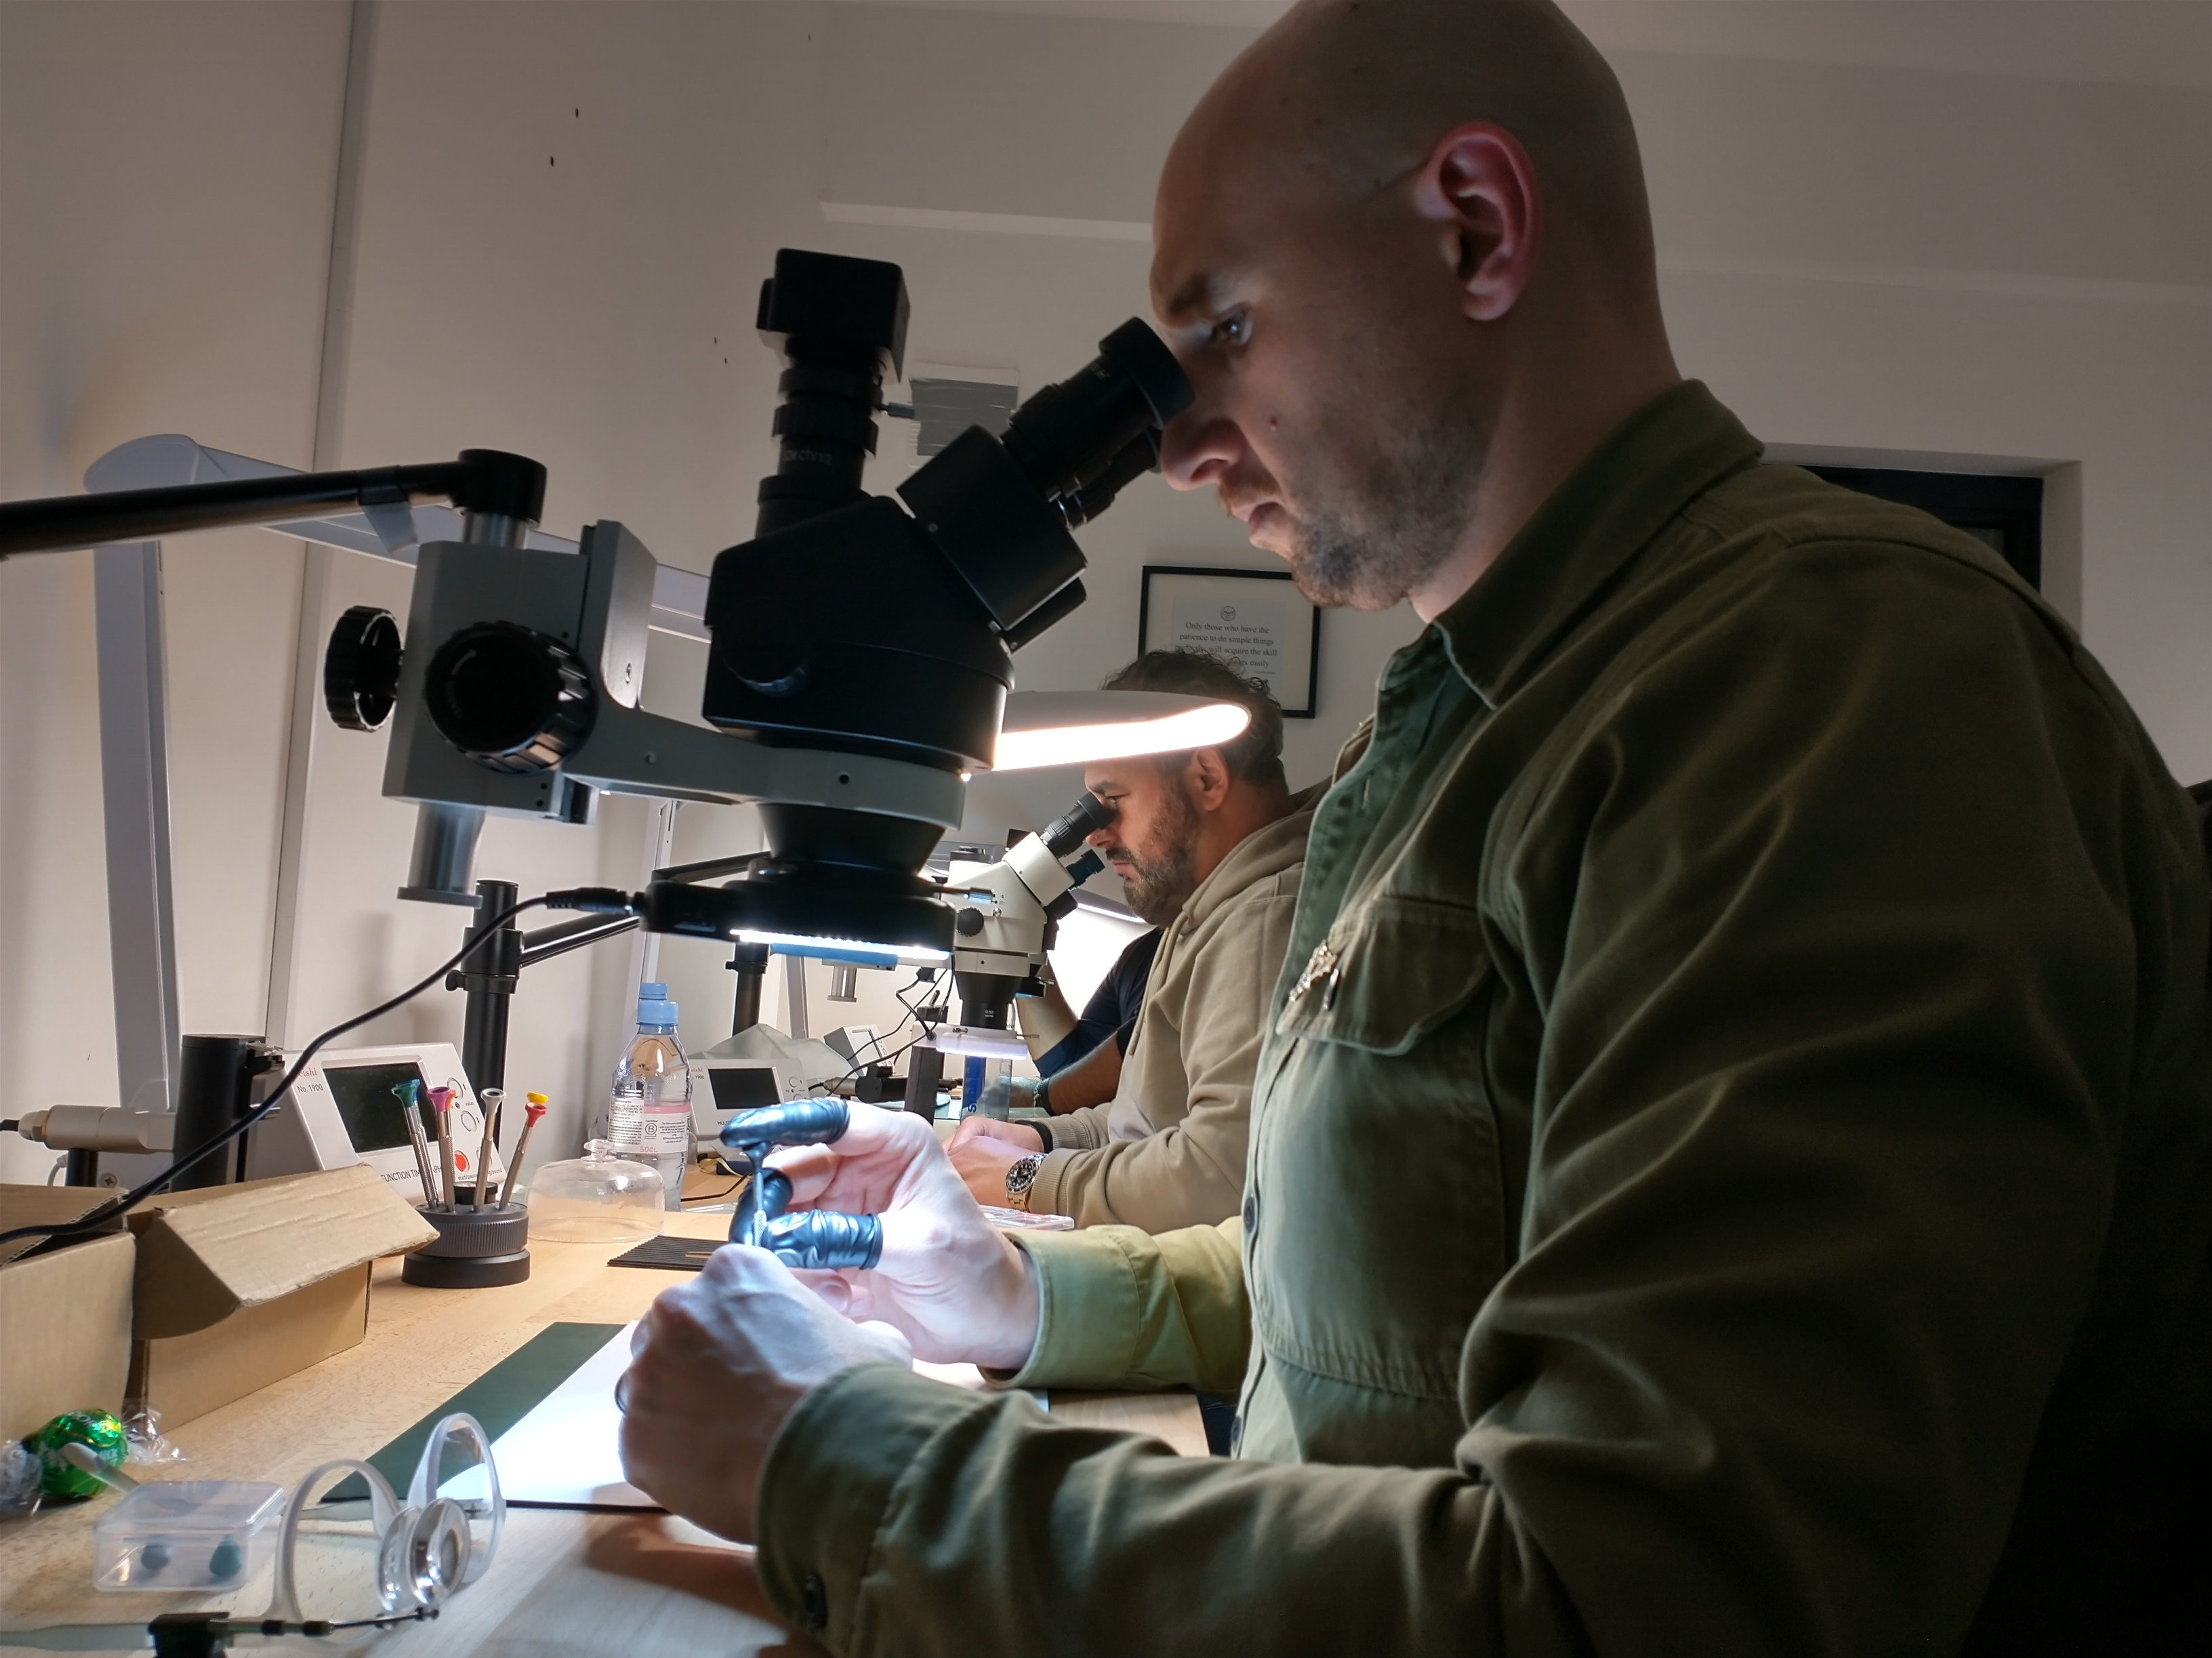
Each student has a their own height adjustable work-bench and a simul-focal stereo microscope to use
There are over 2500 PowerPoint pages of video and pictorial content with detailed instructions and guidance.

Slide 27
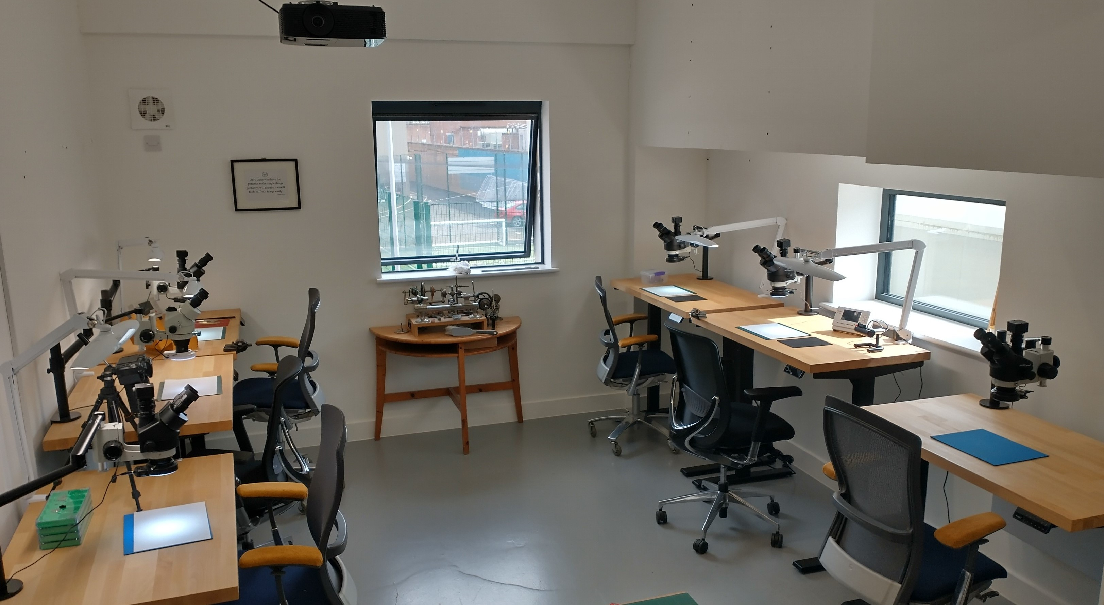
Each student has a their own height adjustable bench, a simul-focal stereo microscope and a ‘starter’ toolkit

Slide 28
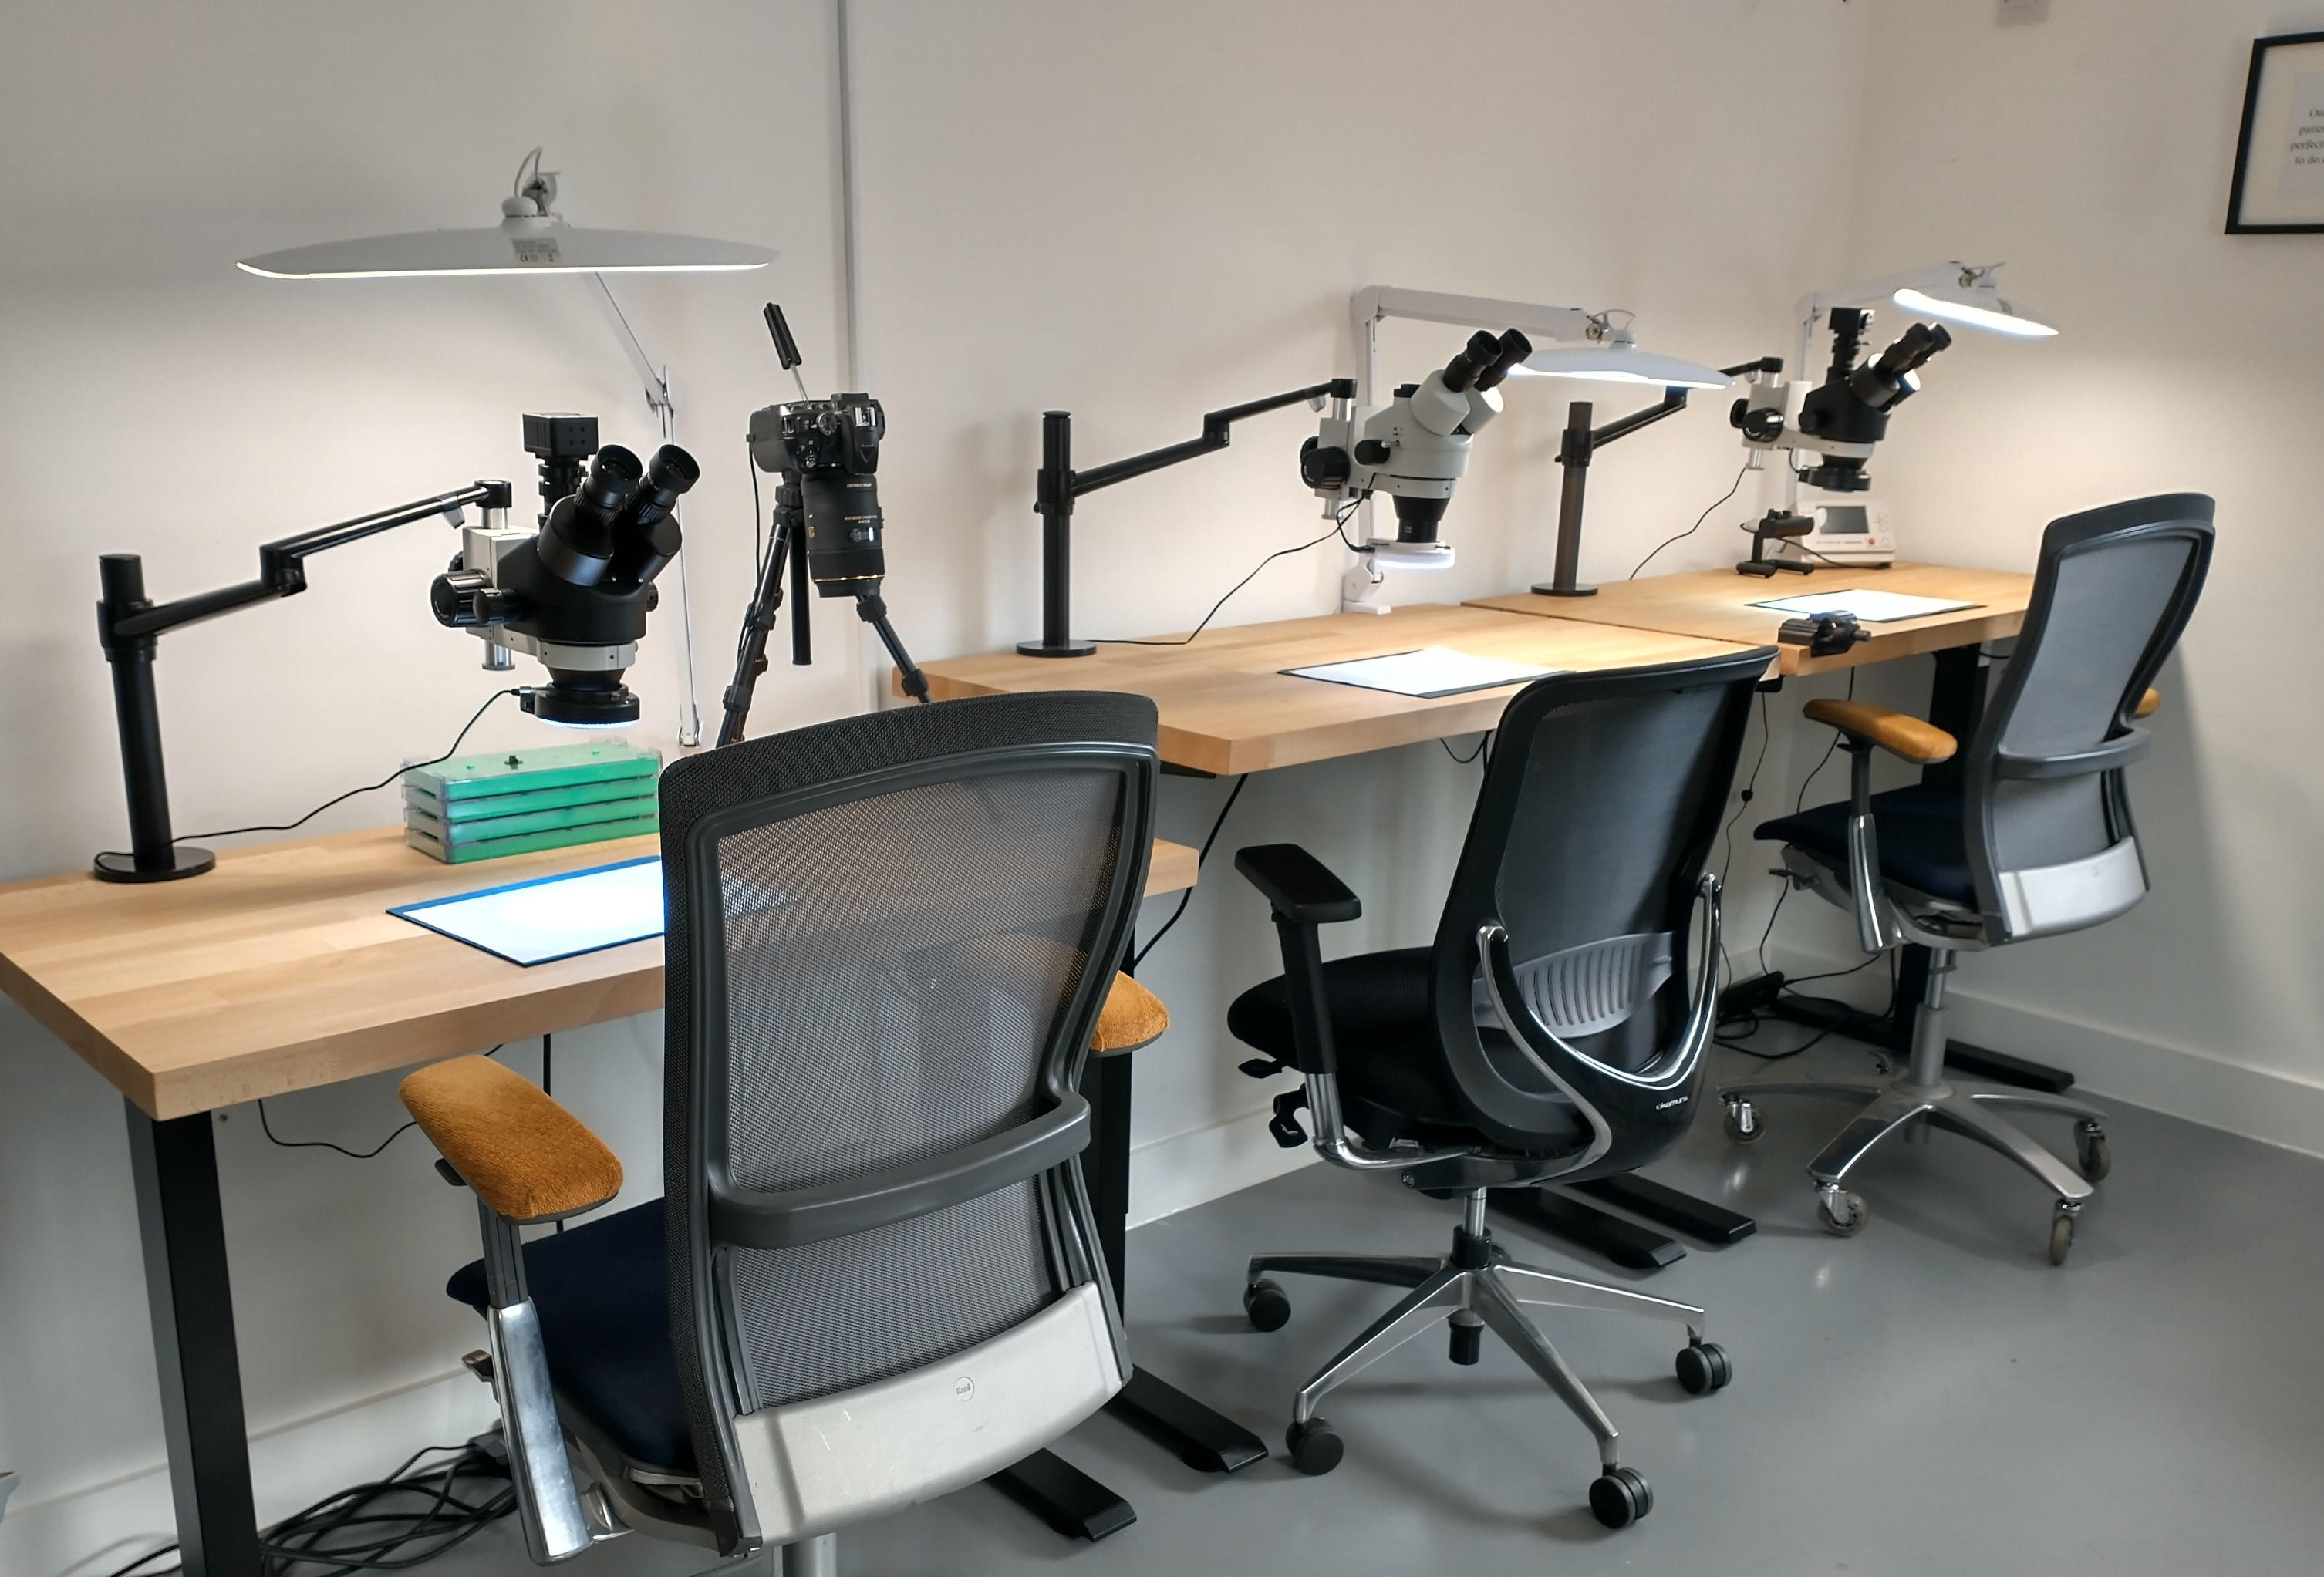

Slide 29
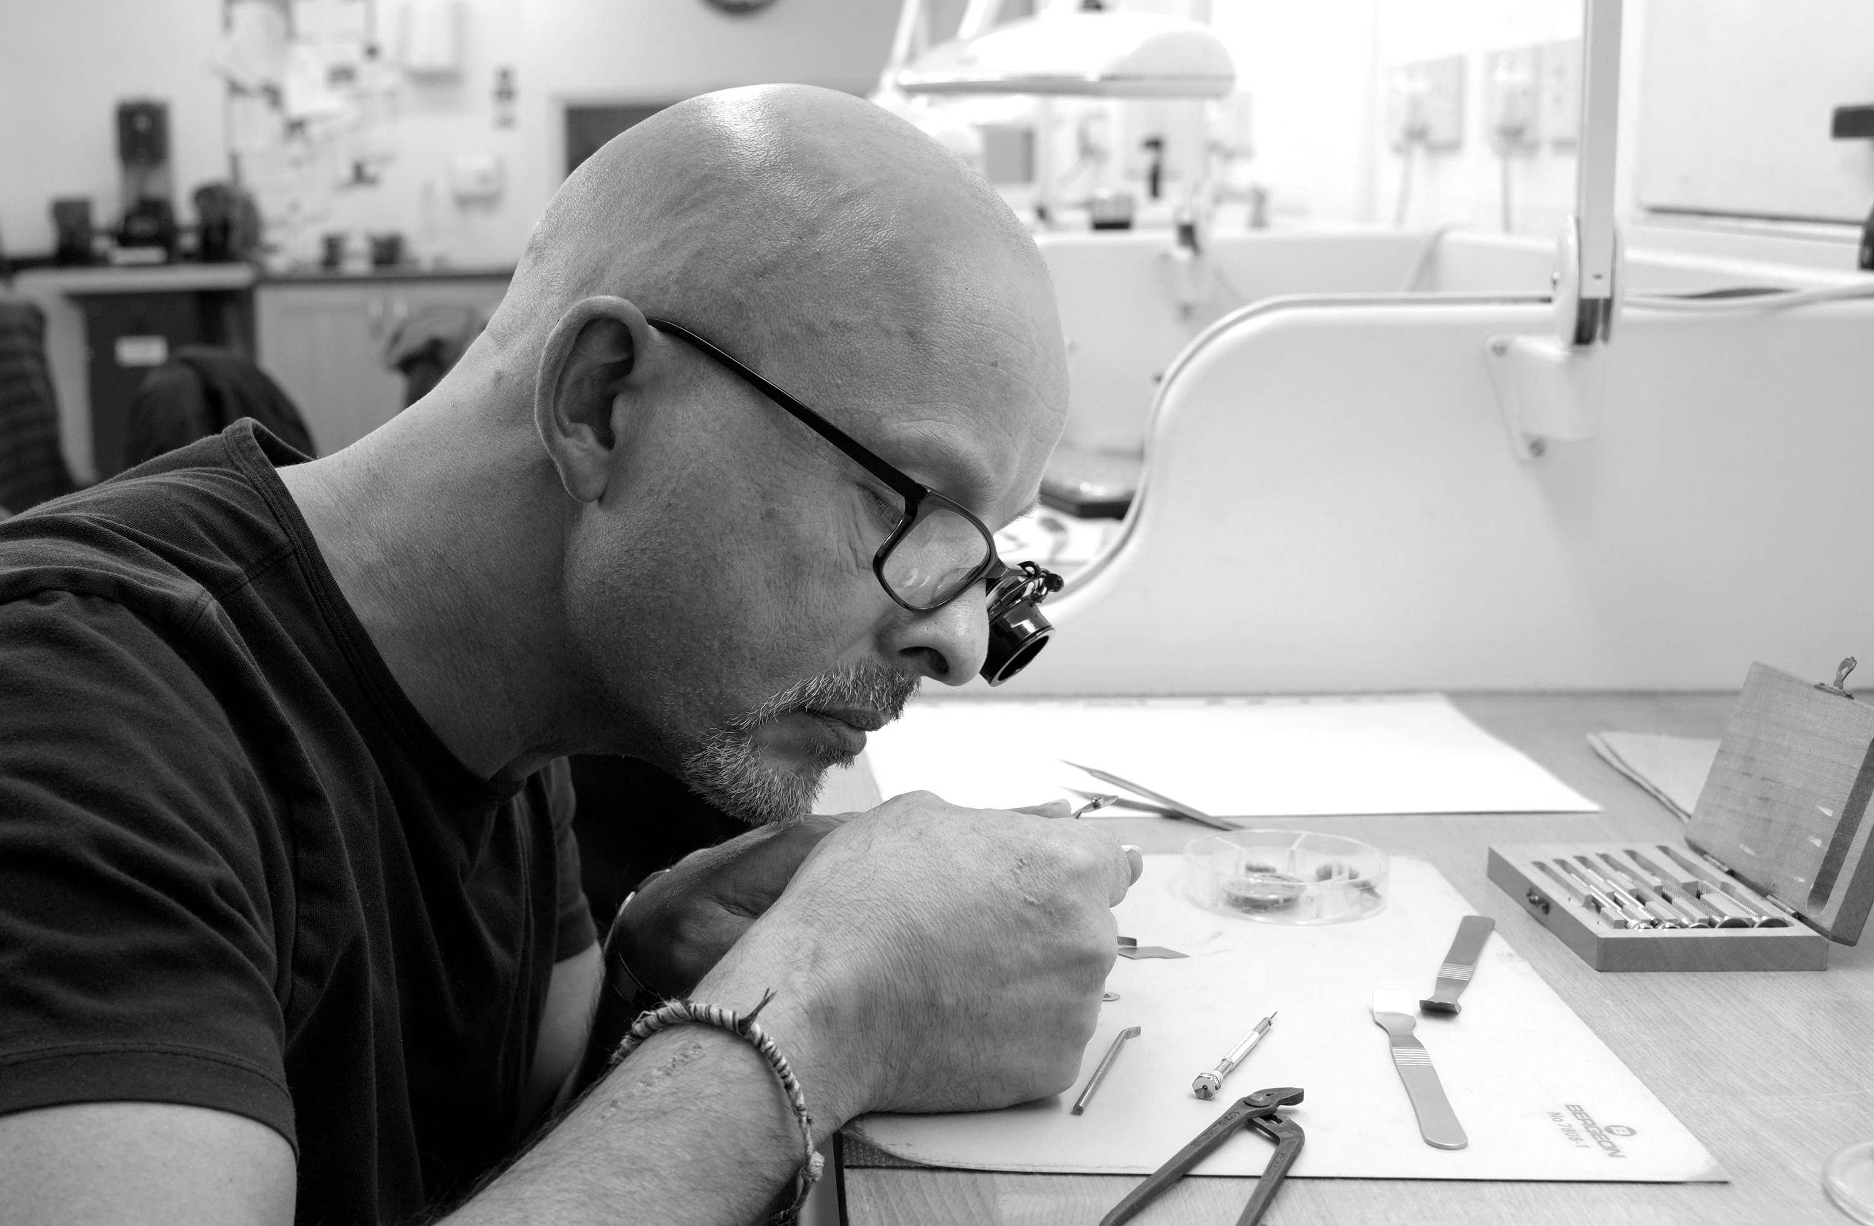
Jon the Watch- Your watchmaking tutor

Slide 30
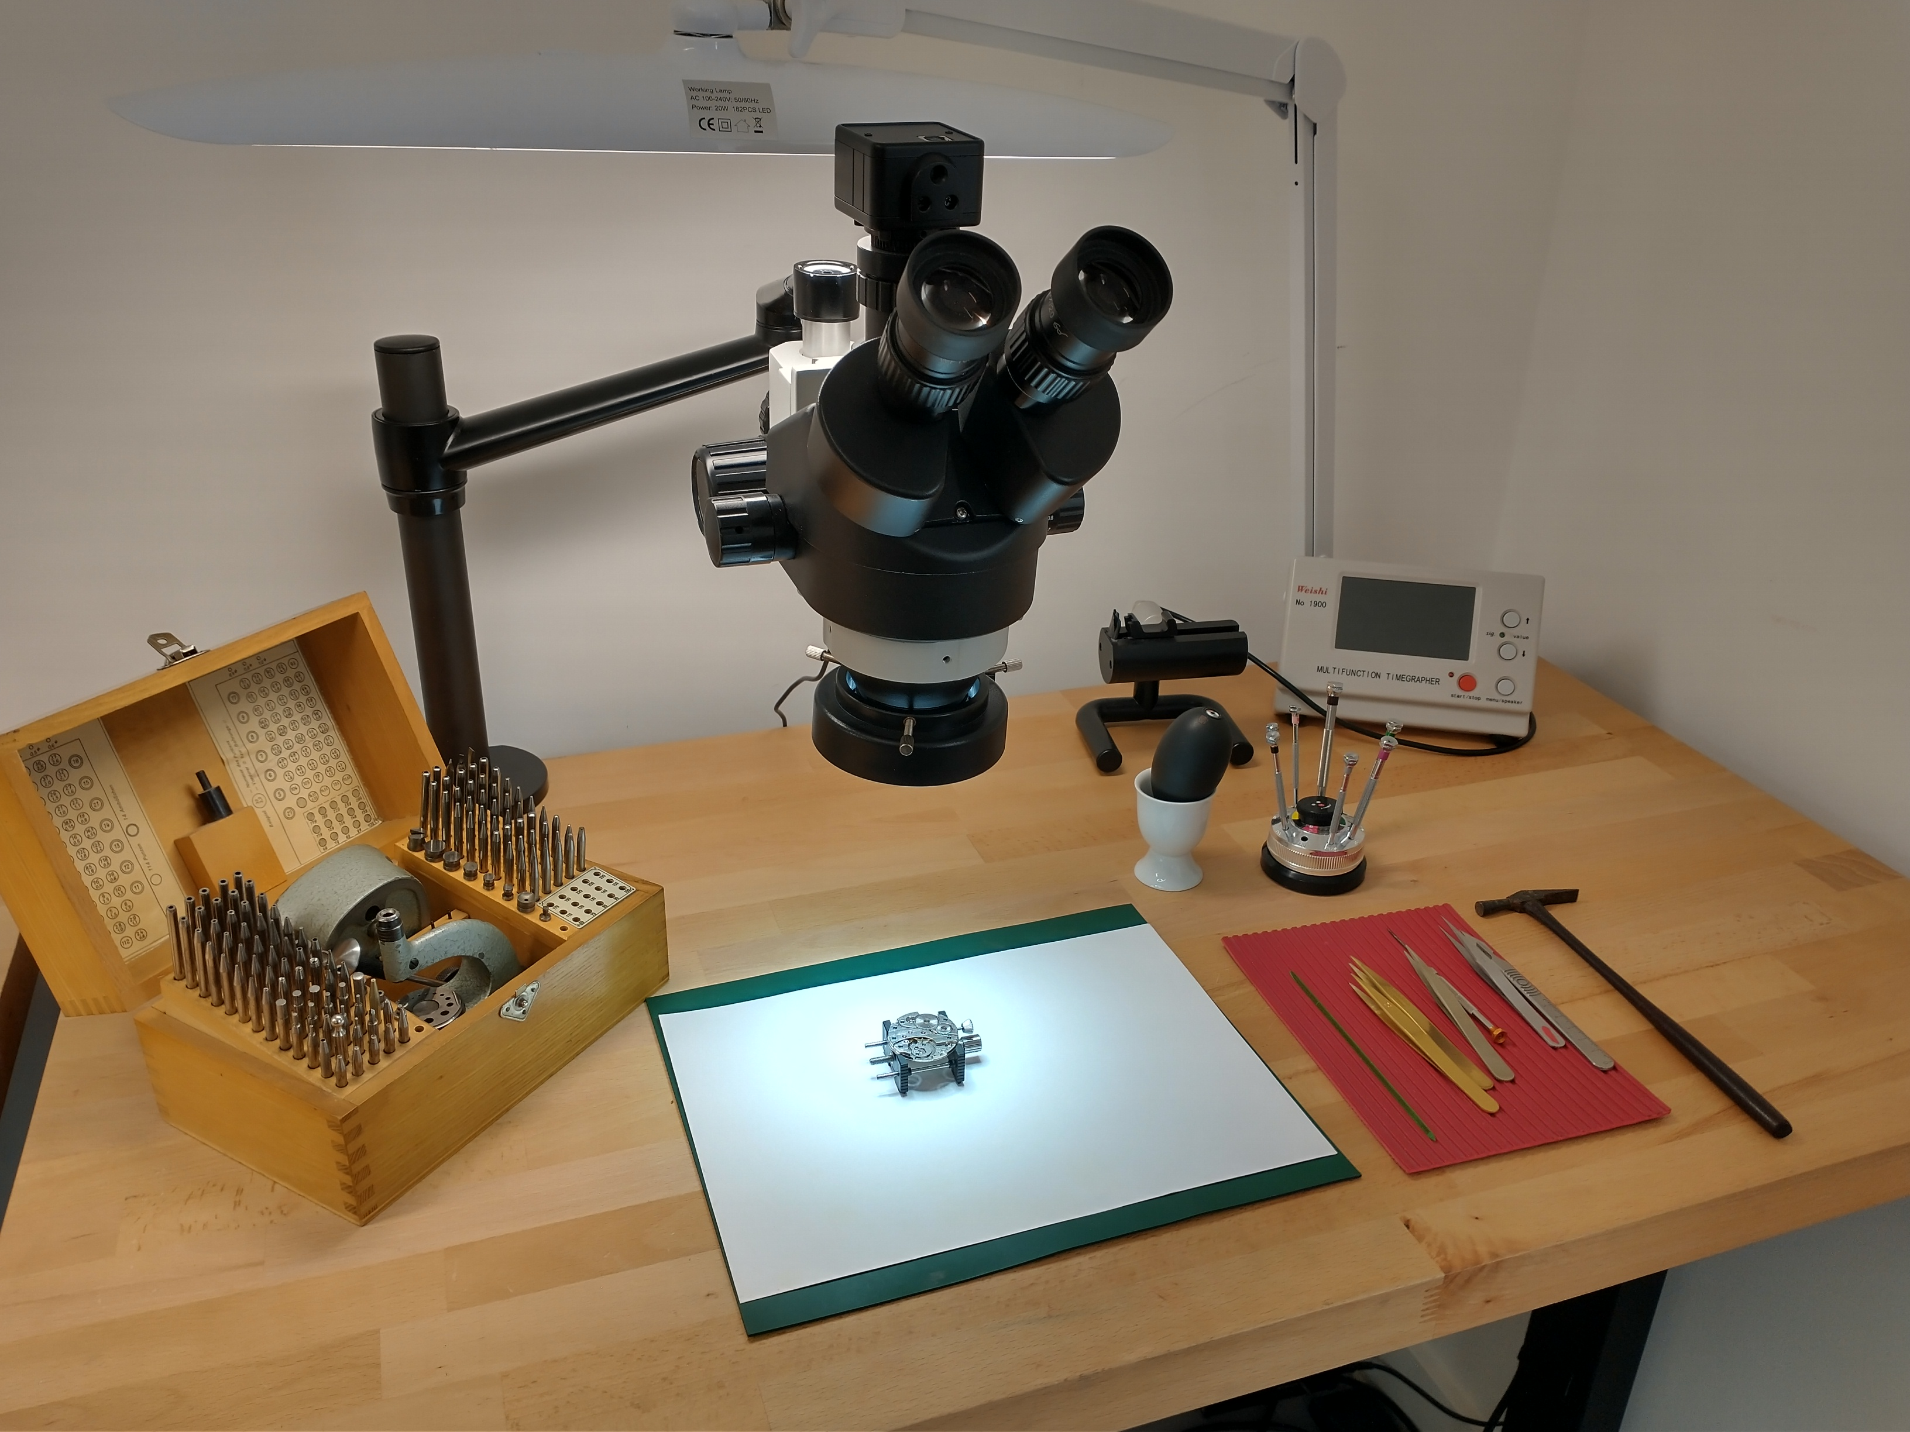
The watch workshop is well equipped with specialised tools and equipment

Slide 31
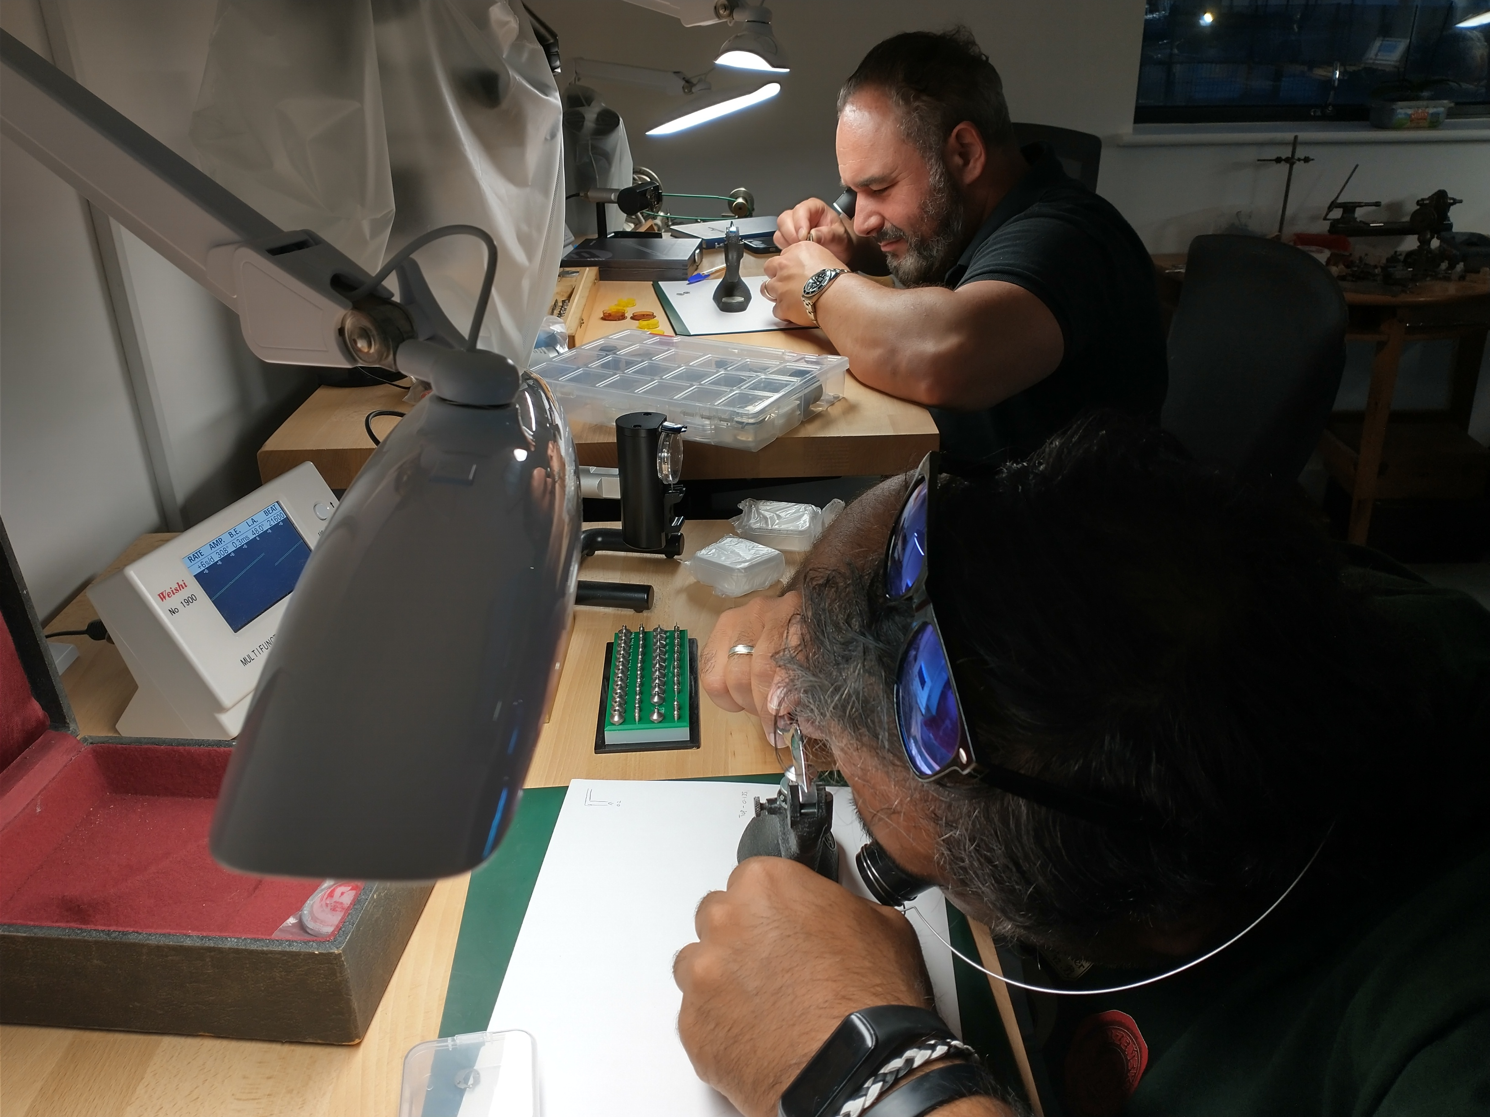
The watch workshop is well equipped with specialised tools and equipment

Slide 32
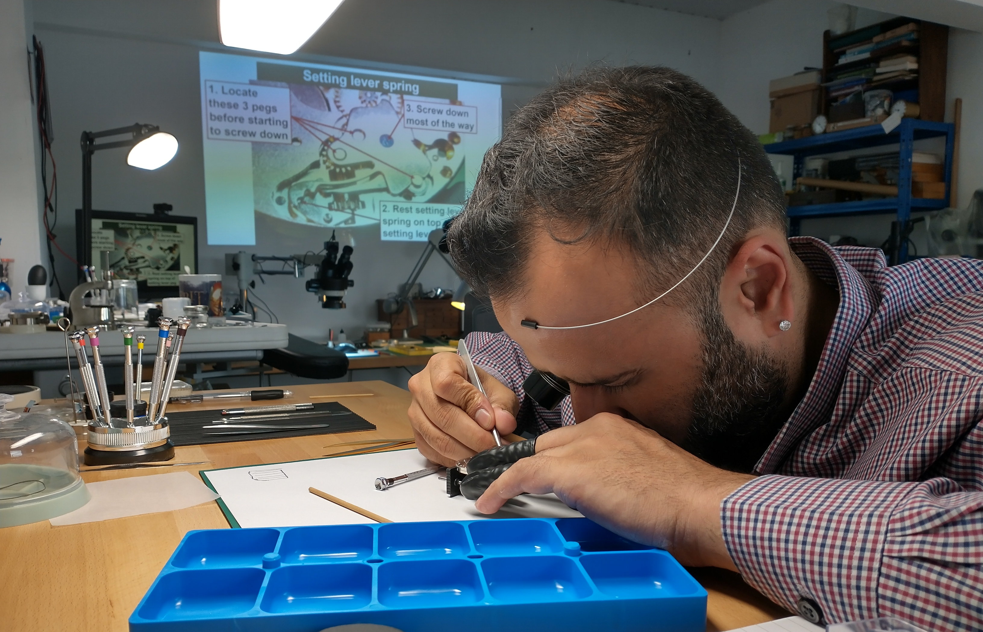
One to one tuition is also provided for

Slide 33
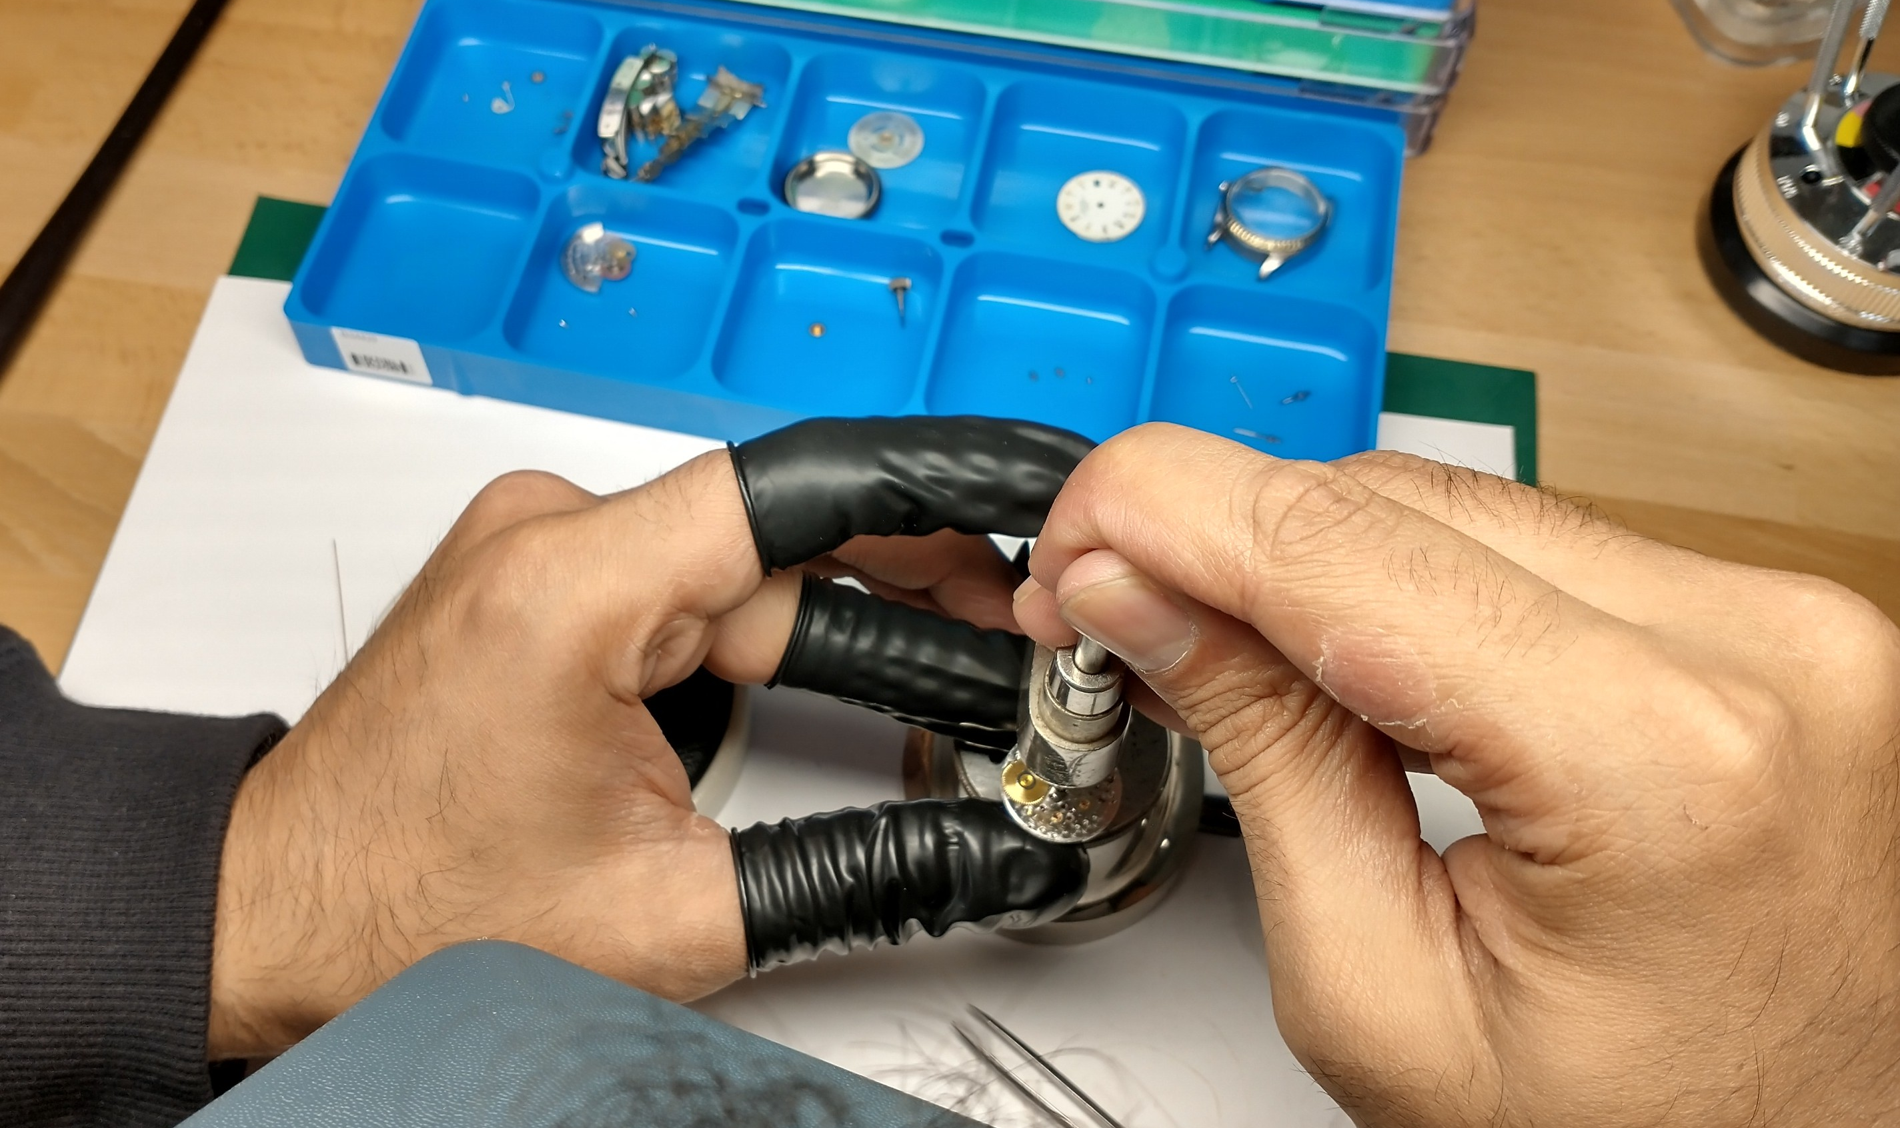

Slide 34
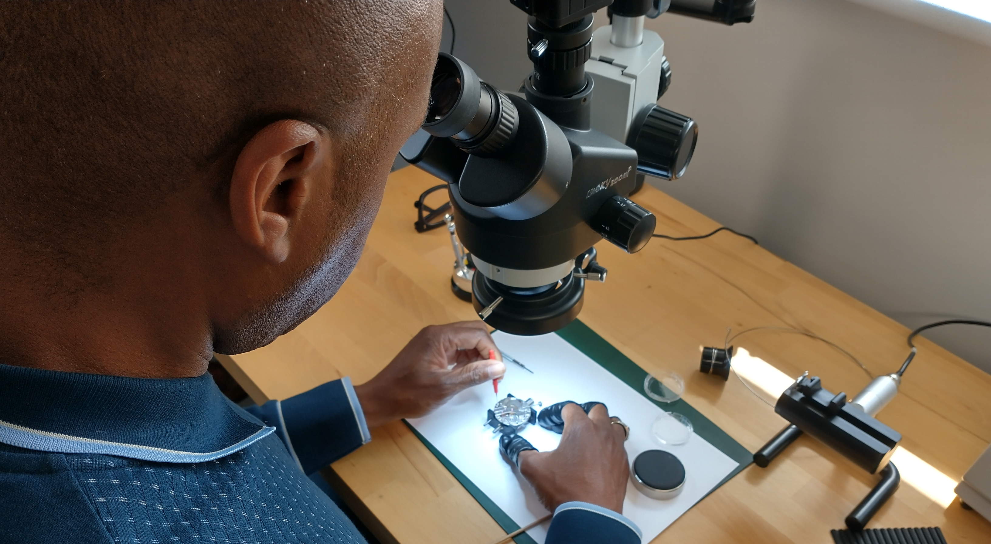

Slide 35
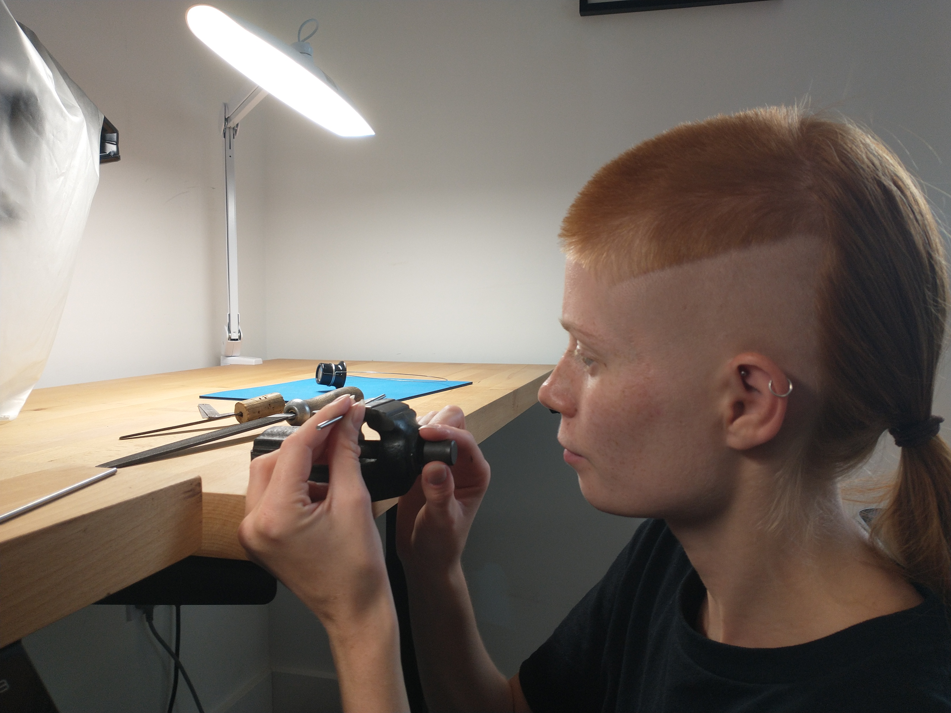
A student from Mr Jones Watches learning how to make a pair of hand leavers

Slide 36
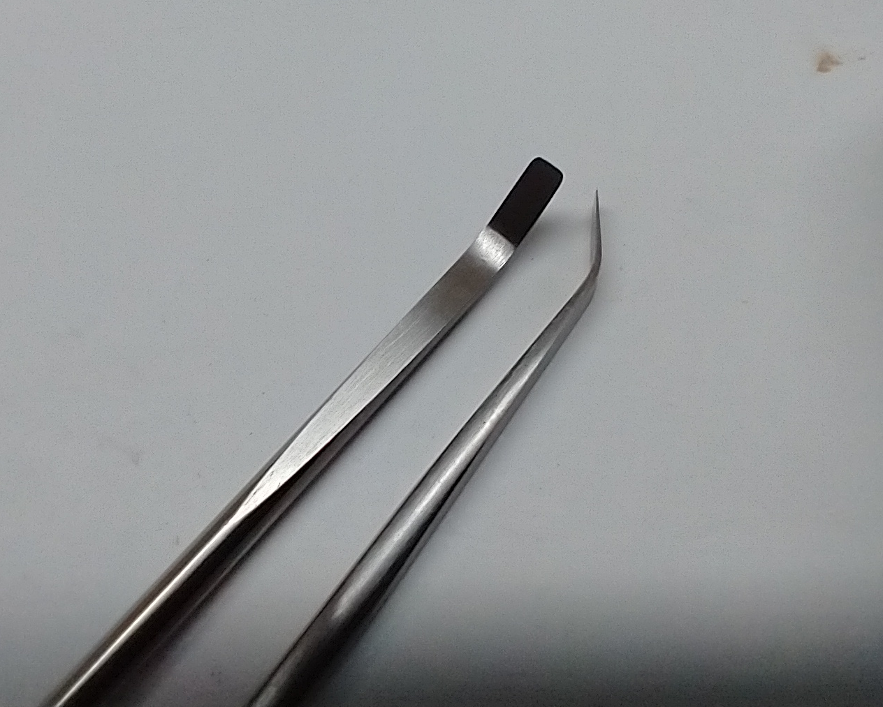
Watch hand levers are made during the first year, learning filing skills, as well as hardening and tempering the tool steel used

Slide 37
Watch costs
The first watch has been bought and is ready for you on the first lesson. There are spare movement parts for breakages.
We will be working on this watch movement for the first 15 to 16 weeks.
I will go into more detail during the course about which watches are to be purchased next. I have chosen watches that can easily be purchased for less than £50 each on eBay. Some may cost more depending on the quality of the movement.
37

Slide 38
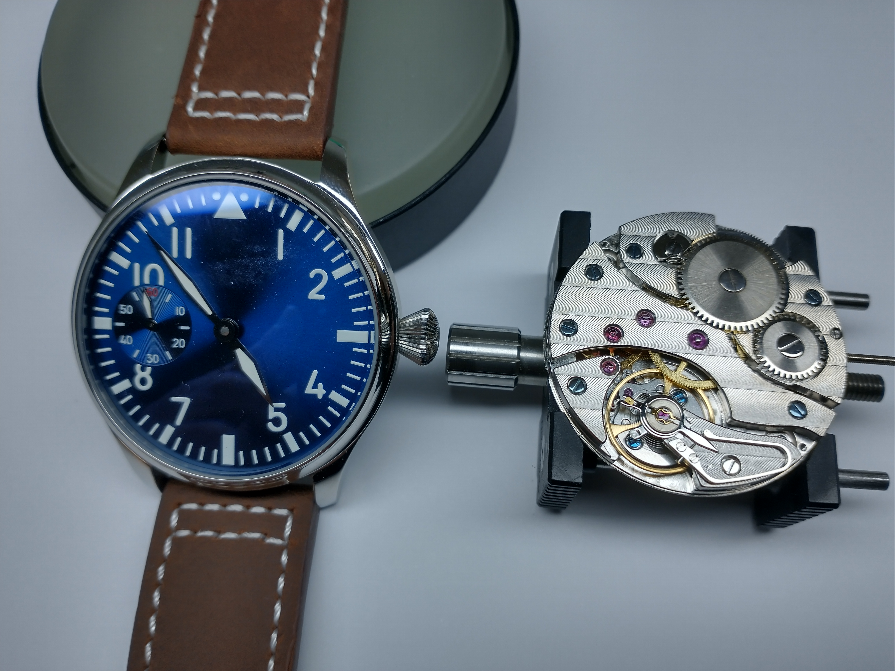
The first watch in the course
38

Slide 39
Course costs and dates
The course cost is £1200 for 120 hours training over 40 weeks.
An additional £80 covers the cost of the first watch and spare parts.
The beginning of term is Tuesday 10th September 2024.
The lessons are held between 6.30pm to 9.30pm.
The course is also being taught online at the same time as the in-classroom lessons for any who can’t physically attend the workshop in London and are somewhere else in the world.
More days are available depending on student demand.
The course is held at Wimbledon Art Studios near Tooting, South London, SW17 0BB. 10 minutes from the nearest tube/mainline.
Nearest tube: Tooting Broadway
Nearest mainline station: Earlsfield
39

Slide 40
Course costs and dates
There are three terms over the academic year, consisting of 40 weeks of lessons.
Term one: Tuesday 10th September to Tuesday 17th December 2024 inclusive
Term two: Tuesday 14th January to Tuesday 25th March 2025 incl.
Term three: Tuesday 8th April to Tuesday 8th July 2025 incl.
40

Slide 41
The last part of the course
This will be a small number of lessons on using the watchmakers lathe.
This will then take us to the end of the year.
There maybe some free lessons at the end of each term and it will be at the discretion of the tutor for you to bring in your own project, or just catch up with the rest of the group if you fell behind.
41

Slide 42
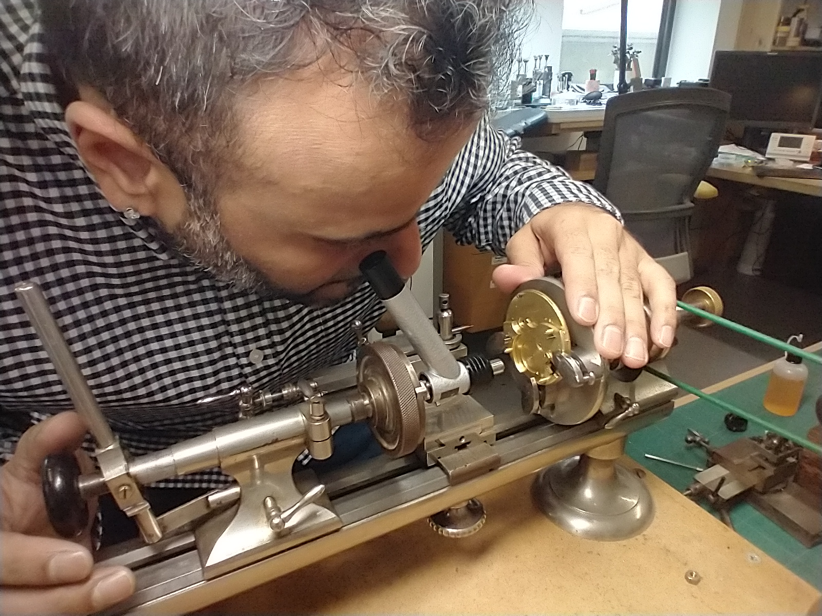
42

